Slide 1
MBC 638 – Summer 2019 Process Improvement Project
NINA WILLIAMS (formerly ECKEL)

Slide 2
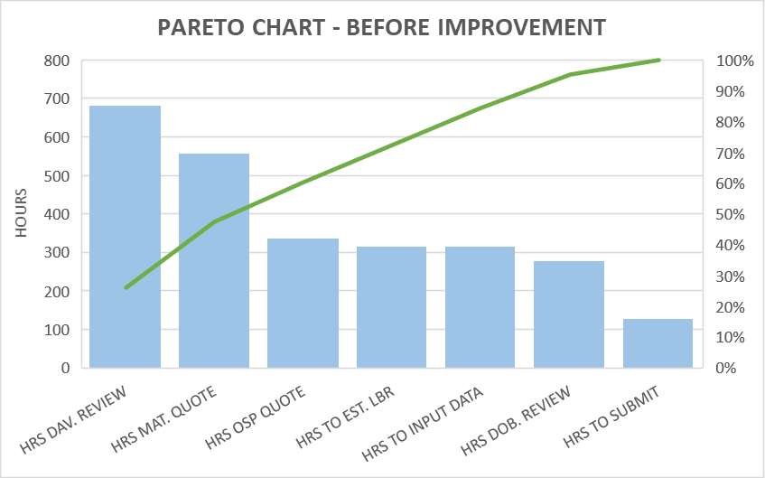
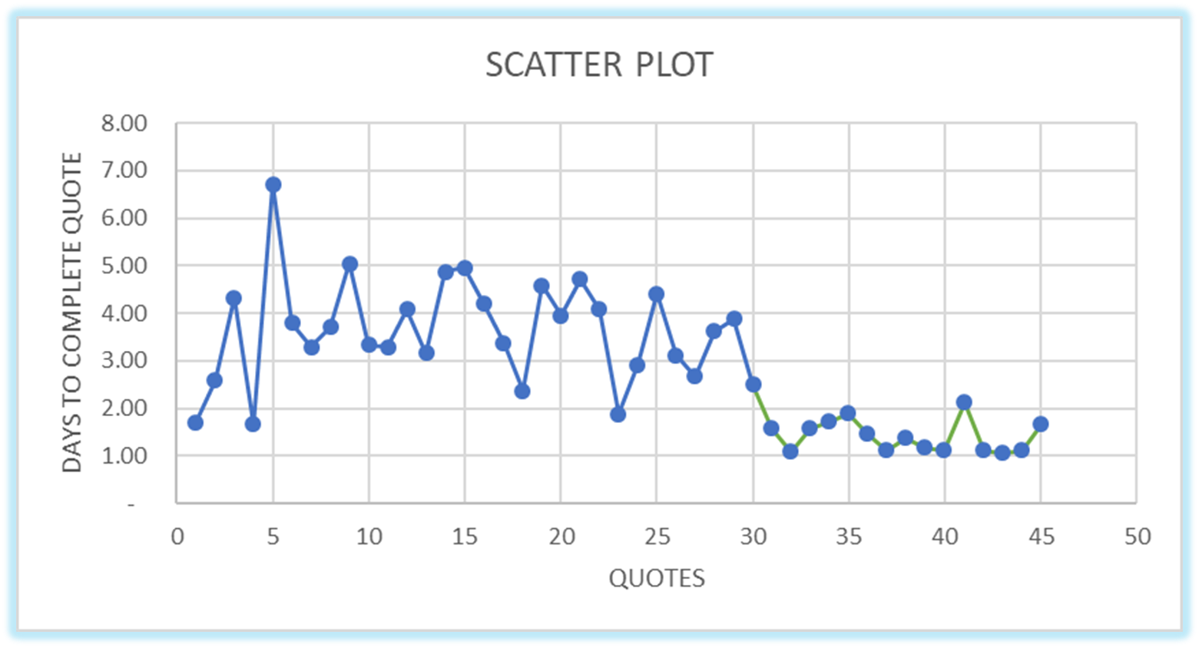
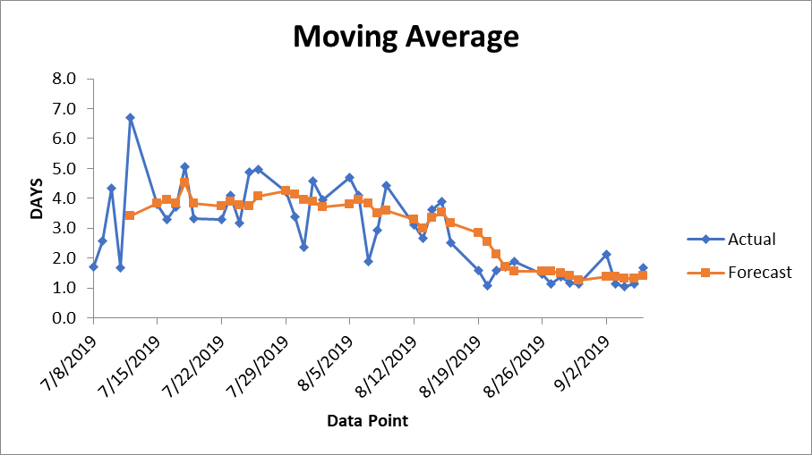

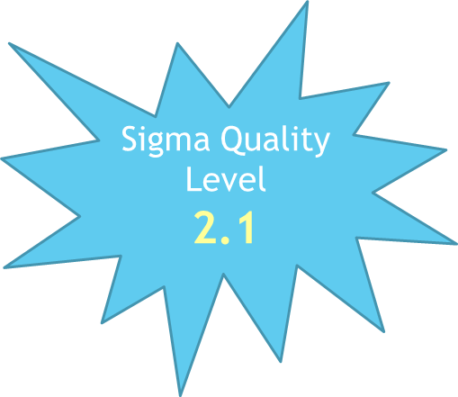
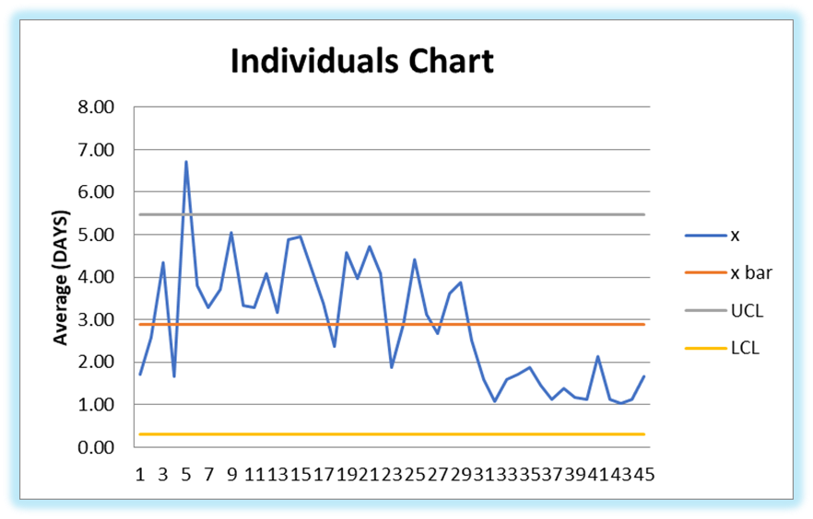

STORYBOARD – Executive Summary – Quoting Time
Key Dates --->
Team Launch
07.07.2019
Define
07.07.2019
Measure
07.08.2019
Analyze
08.18.2019
Improve
08.19.2019
Control
09.07.2019
DEFINE
MEASURE
ANALYZE
IMPROVE
PROBLEM STATEMENT
* Quoting turn around time is too long * Manual Process * Process lacks goal structure * Inconsistent * Unreliable * Losing jobs due to quoting time *
Time Series analysis showing higher quoting time prior to improvement and decreased quoting time after new process implementation
Scatter Plot clearly displays the reduction in quoting time hours from improvement efforts
Sigma Quality Level
3.8
80%
Hours to
focus &
improve
*Review
*Mat Qt
*OSP Qt
*LBR Qt
GOAL:
Complete quotes in 2 days or less!
CONTROL
SUCCESS!!!
BUSINESS IMPACT
* Needs Quicker Process to achieve profitability * Current process will cause business to miss out on profitable opportunities * Improved quote time will increase success *
Mean:
3.6 days to submit quote back to cust.
Regression shows meaningful variables
Control chart shows the new process was implemented and was a success in reducing quoting hours! We will continue with the new process

Slide 3
DEFINE
Problem Statement
Quoting turn around time for RFQ’s is way too long
Business Impact
Needs quicker quoting process to not miss bid opportunities, to obtain new work and achieve profitability
The current process is very manual & time consuming
Process lacks structure, guidelines and timing goals
The process is inconsistent and unreliable
Company often misses RFQ deadlines because they are unable to turnaround the quotes in a timely manner
Operating at the current state will cause the business to lose potential work and miss out on profitable opportunities
Improving the quoting turn-around time will increase the amount of jobs awarded to the business and in turn increase profitability and overall success

Slide 4
CURRENT PROCESS: PROCESS MAP
DEFINE - MEASURE – ANALYZE – IMPROVE - CONTROL
Sigma Quality Level
2.1
The Process Map: provides a graphical tool for documenting the current steps involved to turn around a completed quote.
The daily activities of the quoting process are displayed. This allows us to understand and visualize the current steps involved in producing a quote in response to an RFQ.

Slide 5
SQL - SIGMA QUALITY LEVEL
DEFINE & IMPROVE
DEFECT = When quote turn-around time exceeds 2 days
Our Sigma Quality Level of 3.8 after the process improvements were implemented is higher than our beginning Sigma Quality Level of 2.1. This concludes that our process improvement efforts did in fact decrease our (DPMO) Defects Per Million Opportunities which signifies a positive outcome from our improvement efforts.

Slide 6
DEFINE
SUCCESS MEASURES
GOAL
The goal of this project is to decrease the amount of time (measured in hours & days) spent on completing and submitting a quote to the customer in response to an RFQ (request for proposal). The current average days it takes to complete and submit a quote is 3.6. Our goal is to complete a quote in 2 days or less.
OPERATIONAL DEFINITION
The total days that it takes to complete and submit a quote (Y) is calculated by combining our 7 (X) variable components. These variables are tracked to the nearest hour and consist of the following:
BASELINE
Prior to the improvement, Dobber’s Machine and tool spent an average of 3.6 days from the time an RFQ was received, to the time a quote was completed and submitted to the customer. The Sigma Quality Level of the original process was 2.1
* Hours for David to Review * Hours for Dobber to Review * Hours to Get Material Quote * Hours to Get OSP Quote * Hours for Dobber to Estimate Labor * Hours Till Input Data in Quote Tool * Hours Till Final Analysis to Submit *

Slide 7
MEASURE
Collection Method
Current process data was collected for 6 weeks from 07.08.19 to 08.16.19 totaling 30 quotes
Continuous Data
7 continuous data (x) variables were collected from the DMT Tracker
Improved process data was collected for 3 weeks from 08.19.19 to 09.06.19 totaling 15 quotes
9 weeks of total data collected, Monday thru Friday
Total quote hours were tracked through 7 final variables recorded in the DMT Tracker which is based out of an Excel spreadsheet
* Hours for David to Review * Hours for Dobber to Review * Hours to Get Material Quote * Hours to Get OSP Quote * Hours for Dobber to Estimate Labor * Hours Till Input Data in Quote Tool * Hours Till Final Analysis to Submit *
These 7 (x) data variables were added together to determine the total amount of hours to complete each quote (Y)

Slide 8
DATA MEASUREMENT PLAN
MEASURE

Slide 9
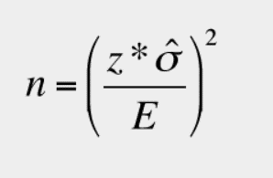
SAMPLE SIZE – CONTINUOUS DATA
MEASURE
SAMPLE SIZE
Data was collected prior to the process improvement on 30 quotes
After the improvement, data was collected on 15 quotes
Total sample size of 45 quotes were collected
According to our sample size calculation, we collected enough samples to provide meaningful analysis in our project
Standard Deviation was calculated based on the days it took to create quotes on the before and after data separately
The Margin of Error was .5
LEVEL OF MEASUREMENT ERROR
Since the time that it took for each of the 7 x variable tasks were manually recorded by David and/or Dobber into the DMT Tracker spreadsheet, there are many possible opportunities for error. This can include how the times were calculated, if they were estimated, how the hours were rounded, etc. The spreadsheet records the hours of the tasks to the nearest whole hour, therefore there can be up to +/- 30 minutes in the variability of the hours that were recorded. David and Dobber were instructed to track the timing of their tasks accurately and so that a reliable and meaningful calculation could be made.

Slide 10
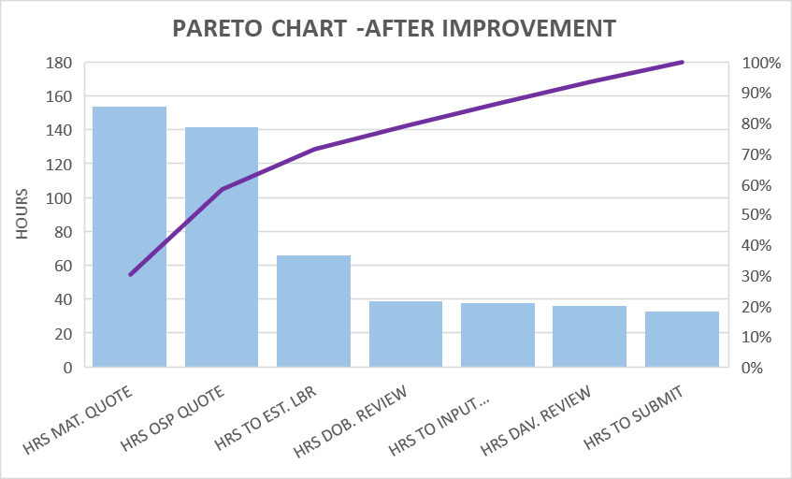
PARETO CHART
DEFINE - MEASURE – ANALYZE – IMPROVE -
BEFORE IMPROVEMENT
AFTER IMPROVEMENT
80% of hours are spent on David reviewing the quote, obtaining the material quote from our suppliers, obtaining the OSP quote from our vendors and estimating the labor hours for the job. The Pareto chart shows us that these are the primary areas that we need to focus our improvement efforts on in order to reduce the hours spent and reach our quote turn around goal of 2 days or less.
After our improvement, we see on our Pareto chart that the hours David would spend to review the quote significantly decreased. We see in the chart that 80% of hours spent after the improvement is on obtaining the material quote from our suppliers, obtaining the OSP quote from our vendors, and estimating the labor hours for the job.

Slide 11
DESCRIPTIVE STATISTICS
DEFINE - MEASURE – ANALYZE – IMPROVE - CONTROL
SUCCESS!!!
Before our improvement, our quoting time process had a range of 5 days with the quickest turn-around time being 1.7 days and the longest being 6.7 days. On average it would take us approximately 3.6 days to complete and submit a quote to our customers.
After our improvement, our quoting time process had a range of 1.1 days with the quickest turn-around time being 1 day and the longest being 2.1 days. On average it would take us approximately 1.4 days to complete and submit a quote to our customers.

Slide 12
IMPROVE
Process Improvement Changes
The first sign that there was a problem with the quoting process at Dobber’s Machine and tool was that DMT was losing the opportunity to bid on RFQ’s because they couldn’t meet the submission deadlines. This is when we knew that there had to be a problem with the existing quoting process and improvements needed to be made
The first thing that stuck out to me when reviewing the Current Process Map, was that David wouldn’t even review the RFQ’s until the end of each day, This alone could cost the company a significant amount of lost time. The new process requires David to review the RFQ immediately once it has been received.
Another issue was that when requesting material and OSP quotes, David would email the suppliers and/or the vendors causing another delay. The new process requires David to call the vendors and/or suppliers and get an immediate quote for material and OSP’s.
The Pareto chart shows that 80% of hours are spent on David reviewing the quote, obtaining the material quote from our suppliers, obtaining the OSP quote from our vendors and estimating the labor hours for the job. After implementing these small but effective changes, we are confident that we will see an improvement to our process and an increased Sigma Quality Level

Slide 13
MULTIPLE REGRESSION ANALYSIS
ANALYZE
BEFORE IMPROVEMENT
Our multiple regression analysis prior to our improvements showed that all 7 of our (X) variables had a very strong relationship to our (Y) variable (time it took to complete and submit a quote to the customer in days)
Both our R and Adjusted R equal 1.0 which is essentially perfect.

Slide 14
MULTIPLE REGRESSION ANALYSIS
ANALYZE
AFTER IMPROVEMENT
Our multiple regression analysis after our improvements were very similar to our results prior to our improvements. It showed that all 7 of our (X) variables had a very strong relationship to our (Y) variable (time it took to complete and submit a quote to the customer in days)
Both our R and Adjusted R equal 1.0 which is essentially perfect.

Slide 15
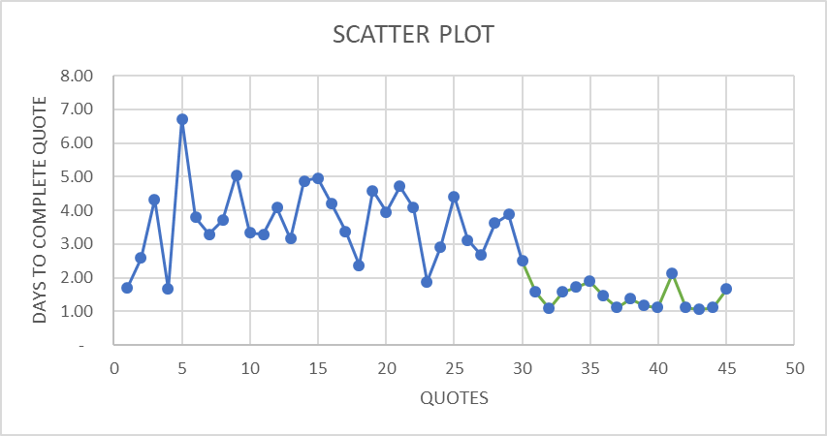
SCATTER PLOT – ALL DATA
MEASURE - ANALYZE - IMPROVE
DAYS PER QUOTE BEFORE & AFTER IMPROVEMENT
We use the Scatter Plot as a graphical tool to visualize the relationship between our quoting process and the amount of days that it takes to complete and return a quote to the customer. The plot also shows us the strength of the relationship.
We implemented our process improvements on quote 31. Here we can clearly visualize and see that once the process was improved, our days to complete a quote were significantly reduced. This signifies a success to our process improvement!

Slide 16
TIME SERIES ANALYSIS– ALL DATA
MEASURE - ANALYZE - IMPROVE
DAYS PER QUOTE BEFORE & AFTER IMPROVEMENT
We use the Time Series Analysis as a graphical tool that can show and track trends or patterns over a specified time period. For this exercise we chose to display the Moving Average chart to visualize forecasts of the actual data.
We see that during the first 6 weeks prior to our improvements our quoting days were ranging from 2-7 days. After our improvement we see that our quoting days were significantly reduced to between 1 and 2 days. The moving average forecast seemed to display results closely and accurately aligned with our actuals.

Slide 17
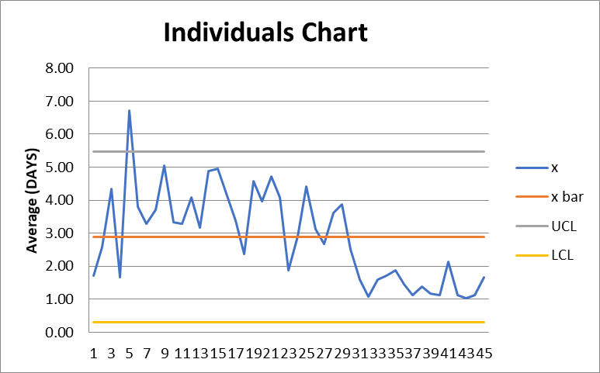
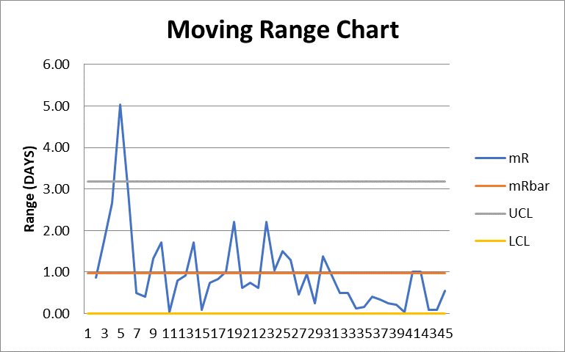
XmR CHART – ALL DATA
MEASURE – ANALYZE – IMPROVE - CONTROL
DAYS PER QUOTE BEFORE & AFTER IMPROVEMENT
The XmR Chart is a statistical tool that is great for problem identification as well as the graphical ongoing monitoring of a process over a period of time. The chart allows the reader to distinguish noise or random variation from an actual signal. These charts assist in providing the ability to visually recognize sources of variation that occurs in a specific process. This ensures that the process is performing consistently and predictably.
In our examples below, we see that the days it took to complete the quoting process from quote 1 to 30 were for the most part above the average and seemed to be too high, signifying that the process was not performing at it’s best. In quotes 31-45 we can see that the quotes were performing below the average and mRbar line signifying that there was indeed a change in process and the process was effective and significantly decreased the days it took to complete and submit a quote to the customer. These results conclude a success in our process improvement efforts.

Slide 18
Summary Conclusion
The overall goal of my project, was to reduce the time it took to complete and submit a quote back to the customer once we received an RFQ (Request For Proposal), from the current process max of 7 days down to our new goal of 2 days or less.
After careful process evaluation and analysis, our end result was an absolute success! We were able to reduce the days it took to complete our quotes from an average of 3.6 days down to an average of 1.4 days!
In order to reach this successful result we used the following processes and analysis which were directly aligned with the DMAIC format.
Carefully defined our Problem Statement and Business Impact.
Developed a current process Process Map to visually analyze our current pain points and areas for improvement opportunities
Calculated our SQL (Sigma Quality Level) to measure our DPMO (Defect Per Million Opportunities) for both before and after our process improvement
Determined our Collection Method and identified our measurements would be Continuous Data
Developed a structured Data Measurement Plan
Analyzed our Sample Size to ensure we had enough measurements to provide meaningful calculations, as well as identified our Level of Measurement Errors.
Created a Pareto Chart on both our before and after improvement data to determine where most of our efforts were being focused.
Investigated our Descriptive Statistics in order to better analyze our data and results
Identified our Process Improvement Changes and plan forward
Performed a Multiple Regression Analysis to determine the meaningfulness of our (X) variables for both before and after our process
Analyzed our before and after days per quote data in Scatter Plot format for a clear visualization
Developed a Moving Average Time Series Analysis and forecast to see how we were performing and expecting to perform over time
Concluded with an XmR Control Chart analysis to evaluate our process performance before and after the improvements were implemented
Outlined our Success Measures, including our Goal, Operational Definition and Baseline

